Slide 1
OXYGEN THERAPY
Module:
Developed with input from MOH, WHO,CDC,IDI

Slide 2
Learning objectives
At the end of this lecture, you will be able to:
Describe importance of oxygen therapy.
Recognize indications for oxygen therapy in Managing Acute Respiratory Infections (including those due to COVID-19) .
Describe how to initiate oxygen therapy.
Describe two different methods to measure blood oxygen levels.
Explain how to titrate oxygen therapy.
HEALTH

Slide 3
Importance of oxygen therapy
Hypoxaemia is a life-threatening condition that can be easily treated with oxygen therapy:
- oxygen therapy saves lives.
Oxygen therapy is an essential medicine that should be available in all areas that may care for SARI patients.
Oxygen therapy is cost-effective.
Oxygen therapy is safe in newborns (preterm and term)
that are hypoxic.
HEALTH

Slide 4
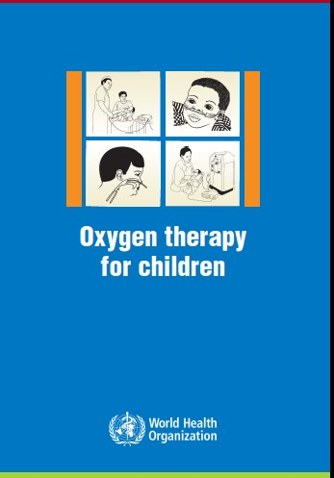
Importance of oxygen thearpy
“Effective oxygen delivery systems should be a universal standard of care and should be made more widely available.” (WHO, 2016)
HEALTH

Slide 5
Oxygen: indications 1/2
In the hospital setting, give oxygen immediately to patients (adults and children) with SARI who have signs of severe illness:
severe respiratory distress
sepsis with hypoperfusion or shock
alteration of mental status
or hypoxaemia
SpO₂ < 90% (if patient is haemodynamically normal)
SpO₂ < 94% (if patient with any emergency signs of airway, breathing or circulation)
SpO₂< 92–95% (if pregnant woman).
Do NOT delay oxygen administration.
HEALTH

Slide 6
Oxygen: indications 2/2
In children, clinical signs that should trigger oxygen therapy include (when pulse oximeter not available):
central cyanosis
nasal flaring
inability to drink or feed (when due to respiratory distress)
grunting with every breath
depressed mental state (i.e. drowsy, lethargic)
and in certain conditions (severe lower chest indrawing, RR ≥ 70 bpm, head nodding).
Do NOT delay oxygen administration.

Slide 7
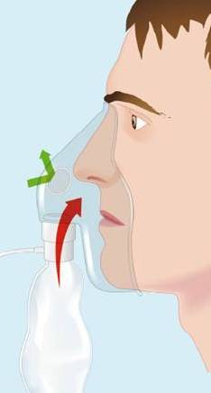
If patient is critically ill, give higher flow rates
In adults and older children, start with 10– 15 l/min via face mask with reservoir bag.
Less ill patients can start with 5 L/min by nasal cannula.
HEALTH

Slide 8
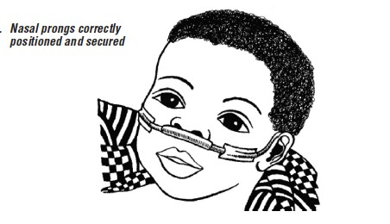
In children < 5 years, preference is nasal cannula
Age of child | Maximal oxygen flow rates
Neonates | 0.5–1.0 L/min by nasal cannula
Infants | 1–2 L/min by nasal cannula
Pre-school aged | 1–4 L/min by nasal cannula
School-aged | 1–6 L/min by nasal cannula
If severe hypoxaemia persists despite maximal flow rates: start CPAP (if available) start secondary source of oxygen with face mask with reservoir bag insert nasopharyngeal catheter (passed uvula into the pharynx) and give oxygen at flow rates: neonates 0.5 L/min; infants 1 L/min.
HEALTH

Slide 9
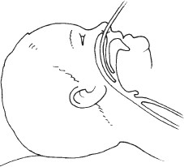
Nasopharyngeal catheter
For severe hypoxaemia:
place passed uvula into the pharynx
provides higher oxygen levels at similar flow rates because of PEEP
needs to be humidified
neonates, dose is 0.5 L/min
infants, dose is 1 L/min
use with nasogastric tube.
HEALTH

Slide 10
Oxygen therapy in children
Compliance may require assistance from nursing staff and family members.
Humidification is not required when using standard flow rates, as natural nasal mechanisms heat and humidify.
FiO₂ is determined by flow rate, nasal diameter and body weight:
– in infants up to 10 kg: 0.5 L/min (35%); 1 L/min (45%); 2 L/min (55%).
HEALTH

Slide 11
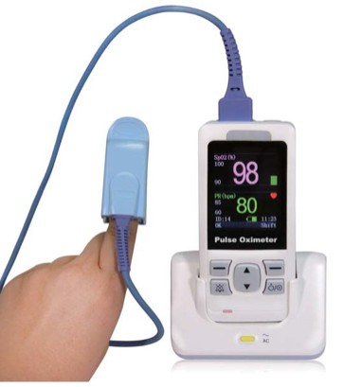
Monitor oxygen levels
Clinical signs are not reliable indicators of hypoxaemia.
Pulse oximeters should be available in all settings caring for patients with SARI and used to measure the SpO₂
- pre-hospital, emergency area, ward, and ICU.
Blood gas analyser should be available in the ICU:
– measures pH, PO₂, and PCO₂ for patients on mechanical ventilation, with severe hypoxaemia, risk of hypercapnea and shock states.
HEALTH

Slide 12
Oxygen titration to reach target
Titrate oxygen to target:
SpO₂ ≥ 90% in adults and children
SpO₂ ≥ 92–95% in pregnant patients
SpO₂ ≥ 94% if child or adult with signs of multi-organ failure, including shock, alteration of mental status, severe anaemia until resuscitation has stabilized patients, then resume target ≥ 90%.
Titrate oxygen up and down to achieve target.
Wean oxygen when patient is stable.
HEALTH

Slide 13
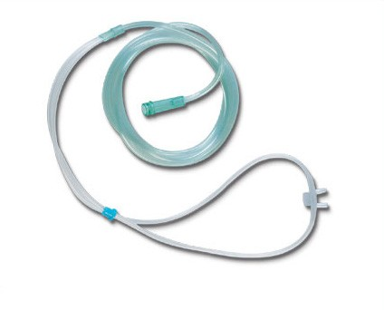
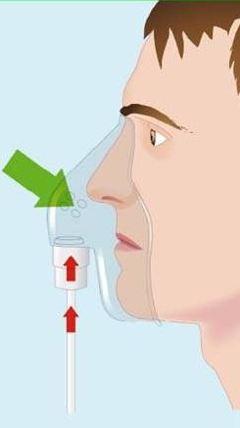
Titrate oxygen:
use appropriate dose and delivery device
Medical Illustration, Leicester Royal Infirmary,
Leicester, UK
Make sure bag is full
O₂ dose 1–5 L/min
O₂ dose 6–10 L/min
O₂ dose 10–15 L/min
FiO₂ estimate 0.25–0.40
FiO₂ estimate 0.40–
0.60
FiO₂ estimate 0.60–0.95
Nasal cannula
Simple face mask
Face mask with
HEALTH
EMERGENCI
ES
reservoir bag

Slide 14
IPC and oxygen therapy
Ensure single patient use of nasal prongs, simple face masks and face masks with reservoir bag to prevent nosocomial infection.
Humidification is not necessary when delivering low flow rates. The oropharynx and nasopharynx provide sufficient humidity.
- In children, flow rates are considered high when
> 2 L/kg/min.
Avoid bubble bottles because of risk of infection.
HEALTH

Slide 15
Recognize acute hypoxaemic respiratory failure
Patients not responding to increasing oxygen therapy are developing acute hypoxaemic respiratory failure:
signs of severe respiratory distress
hypoxaemia (SpO₂ < 90%) despite escalating oxygen therapy
SpO₂/FiO₂ < 300 while on at least 10 L/min oxygen therapy
Cardiogenic pulmonary oedema not primary cause.
HEALTH

Slide 16
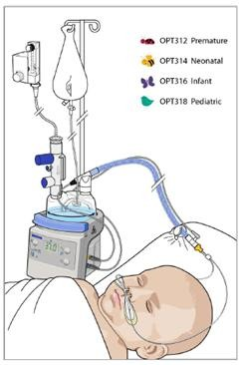
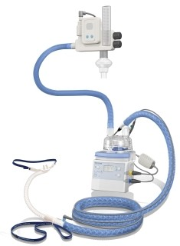
High-flow oxygen system for
acute hypoxemic respiratory failure
High-flow oxygen systems can be used for adults and children:
Selected patient must be awake, cooperative, haemodynamically stable without urgent need for intubation.
May generate aerosols so should be used with airborne precautions.
HEALTH

Slide 17
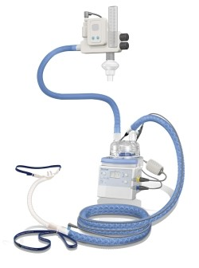
High-flow oxygen system
Comfortable nasal cannula interface.
Reliably titrates FiO₂ up to 100%.
Humidification prevents dryness.
In adults, delivers flow rates as high as 60 L/min.
In infants and young children, maximum flow rates are less, based on age and weight:
– i.e. 2 L/kg/min up to maximum of 60 L/min
HEALTH

Slide 18
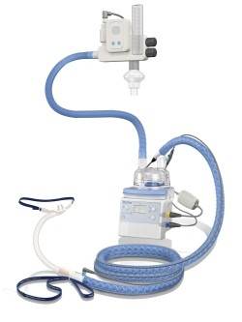
High-flow oxygen therapy
Aims to match patient’s inspiratory demand.
Reduces work of breathing.
Washes out nasopharyngeal dead space.
Provides low level of PEEP.
May induce less injury to the lung in ARDS.
Monitor closely for need for intubation.
HEALTH

Slide 19
Tips: about oxygen use
Appropriate use of oxygen will optimize quality care and minimizes waste.
When using traditional nasal cannula and face mask, increasing flow rates does not reliably deliver higher oxygen concentrations (FiO₂), because patients also breathes in room air, which dilutes oxygen making exact FiO₂ variable.
HEALTH

Slide 20
Useful website
http://www.who.int/patientsafety/safesurgery/pulse_oximetry/tr_material/en/
HEALTH

Slide 21
Summary
Give oxygen immediately to patients with SARI with severe respiratory distress, sepsis with hypoperfusion/shock or hypoxaemia, SpO₂ <90%.
In critically ill adults and children start with highest flow rate available and appropriate for age.
Pulse oximeters should be available in all areas where emergency oxygen is
delivered. Blood gas analyzer should be available in the ICU to also measure ventilatory parameters (pH, PaCo2)
Titrate oxygen to target SpO₂ ≥90% in adults and children, > 92-95% in
pregnant females, or ≥94% during resuscitation of patient with multi-organ failure using the appropriate dose (flow rate) and delivery device.
Newer high flow oxygen systems can be used in select cases of non- hypercapneic, hypoxemic respiratory failure.
HEALTH

Slide 22
Acknowledgements
Contributors
Dr T Eoin West, University of Washington, Seattle, USA
Dr Janet V Diaz, WHO Consultant, San Francisco, USA
Dr Arjun Karki, Patan Academy of Health Sciences, Kathmandu, Nepal
Dr Niranjan Bhat, Johns Hopkins University, Baltimore, USA
Dr Timothy Uyeki, Centers for Disease Control and Prevention, Atlanta, USA
Dr Simon Mardel, University Hospital of South Manchester NHS Foundation Trust Dr Paula Lister, Great Ormond Street Hospital, London, UK
Dr Neill Adhikari, Sunnybrook Health Sciences Centre, Toronto, Canada
Dr Andy Petros, Great Ormond Street Hospital, London, UK
HEALTH

